Slide 1

Developmental Robotics and Artificial Intelligence
Hamza Farooq (2016-CS-122)
Komal Shehzadi (2016-CS-178)

Slide 2
Developmental Robotics
Robots with lifelong child-like learning nature
DevRob also called epigenetic robotics or ontogenetic robotics.
Involve to model the development of increasingly complex cognitive processes in natural and artificial systems
To understand how such processes emerge through physical and social interaction

Slide 3
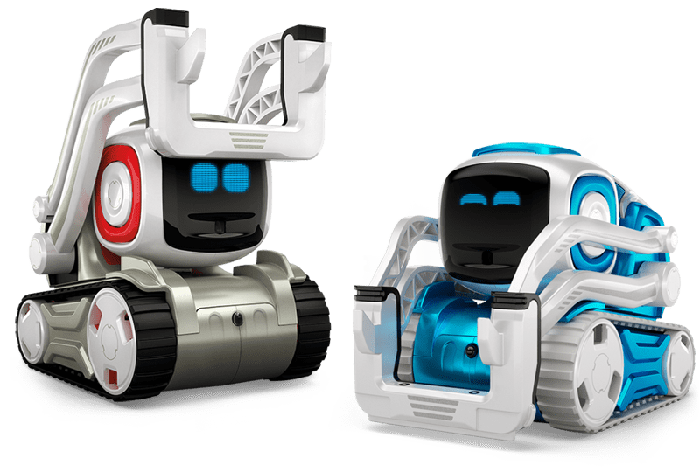
- Types of DevRob - Socially oriented interaction
Socially oriented interaction that involve human-like interaction like conversation with robots.
Examples are Social Robots and virtual assistants.
Cozmo is a socially active, machine learning based robot. It learns with human interaction. It can play games with humans. Provided with built-in integrated development environment, one can use code blocks to program the robot.

Slide 4
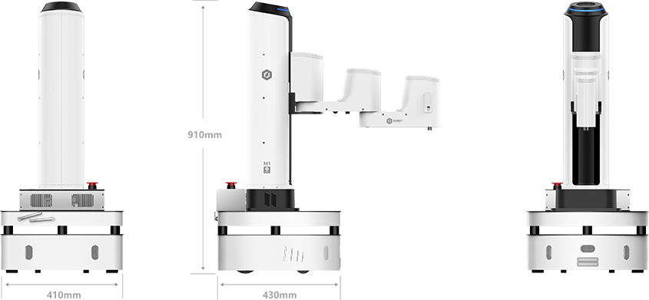
- Types of DevRob - Non-social interaction
Non-social interaction that gather data from sensors to perceive their surroundings and no direct human-like interaction.
Examples include perceptual categorization and navigation.
Dobot M1 is a professional robot arm loaded with sensors. It can be a 3d-printing machine, Laser engraver and hand tool. Multiple robot arms can be connected and synchronized for a group task.

Slide 5
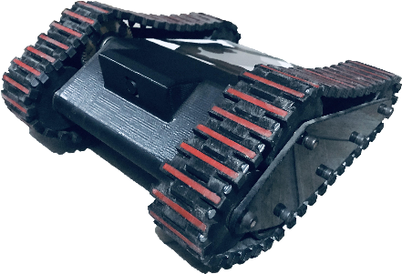
- Types of DevRob - Agent-centered Sensorimotor control
Agent-centered sensorimotor control is exploration of morphological changes of bodily capabilities.
Examples are skill acquisition robots.
Scorpio is an agent-based robot. It supports livestream over Wi-Fi. Computer Vision algorithms are loaded on a PC-based IDE. Interaction commands are transcoded over the internet so that morphological learning against the environment perception can be easily automated

Slide 6

- Types of DevRob - Mechanisms And Principles
Mechanisms and principles include the simulation of theoretical mechanisms through computer software.
Examples are AI based predictive designing computer software.
BIM+ is abbreviation of Building Information Modelling. It is an artificial intelligence based, clash-free, predictive construction software used by millions of engineers and construction works worldwide.

Slide 7
AI and DevRob
It is not an easy task to mimic the cognitive thoughts of human The AI techniques and algorithms used to introduce cognition in a robot mind and Robots implementing different AI techniques and algorithms are compared in the table below
 | Ubtech’s Alpha 1s | Boston Dynamics’ Spot | Pepper | Softbank’s Nao
Speech Recognition | ✓ | ✕ | ✕ | ✓
Gesture Recognition | ✓ | ✓ | ✓ | ✓
Text Recognition | ✕ | ✕ | ✕ | ✓
Path Finding | ✓ | ✓ | ✓ | ✓
Text to Speech | ✕ | ✕ | ✕ | ✓

Slide 8
Thank You

